Slide 1


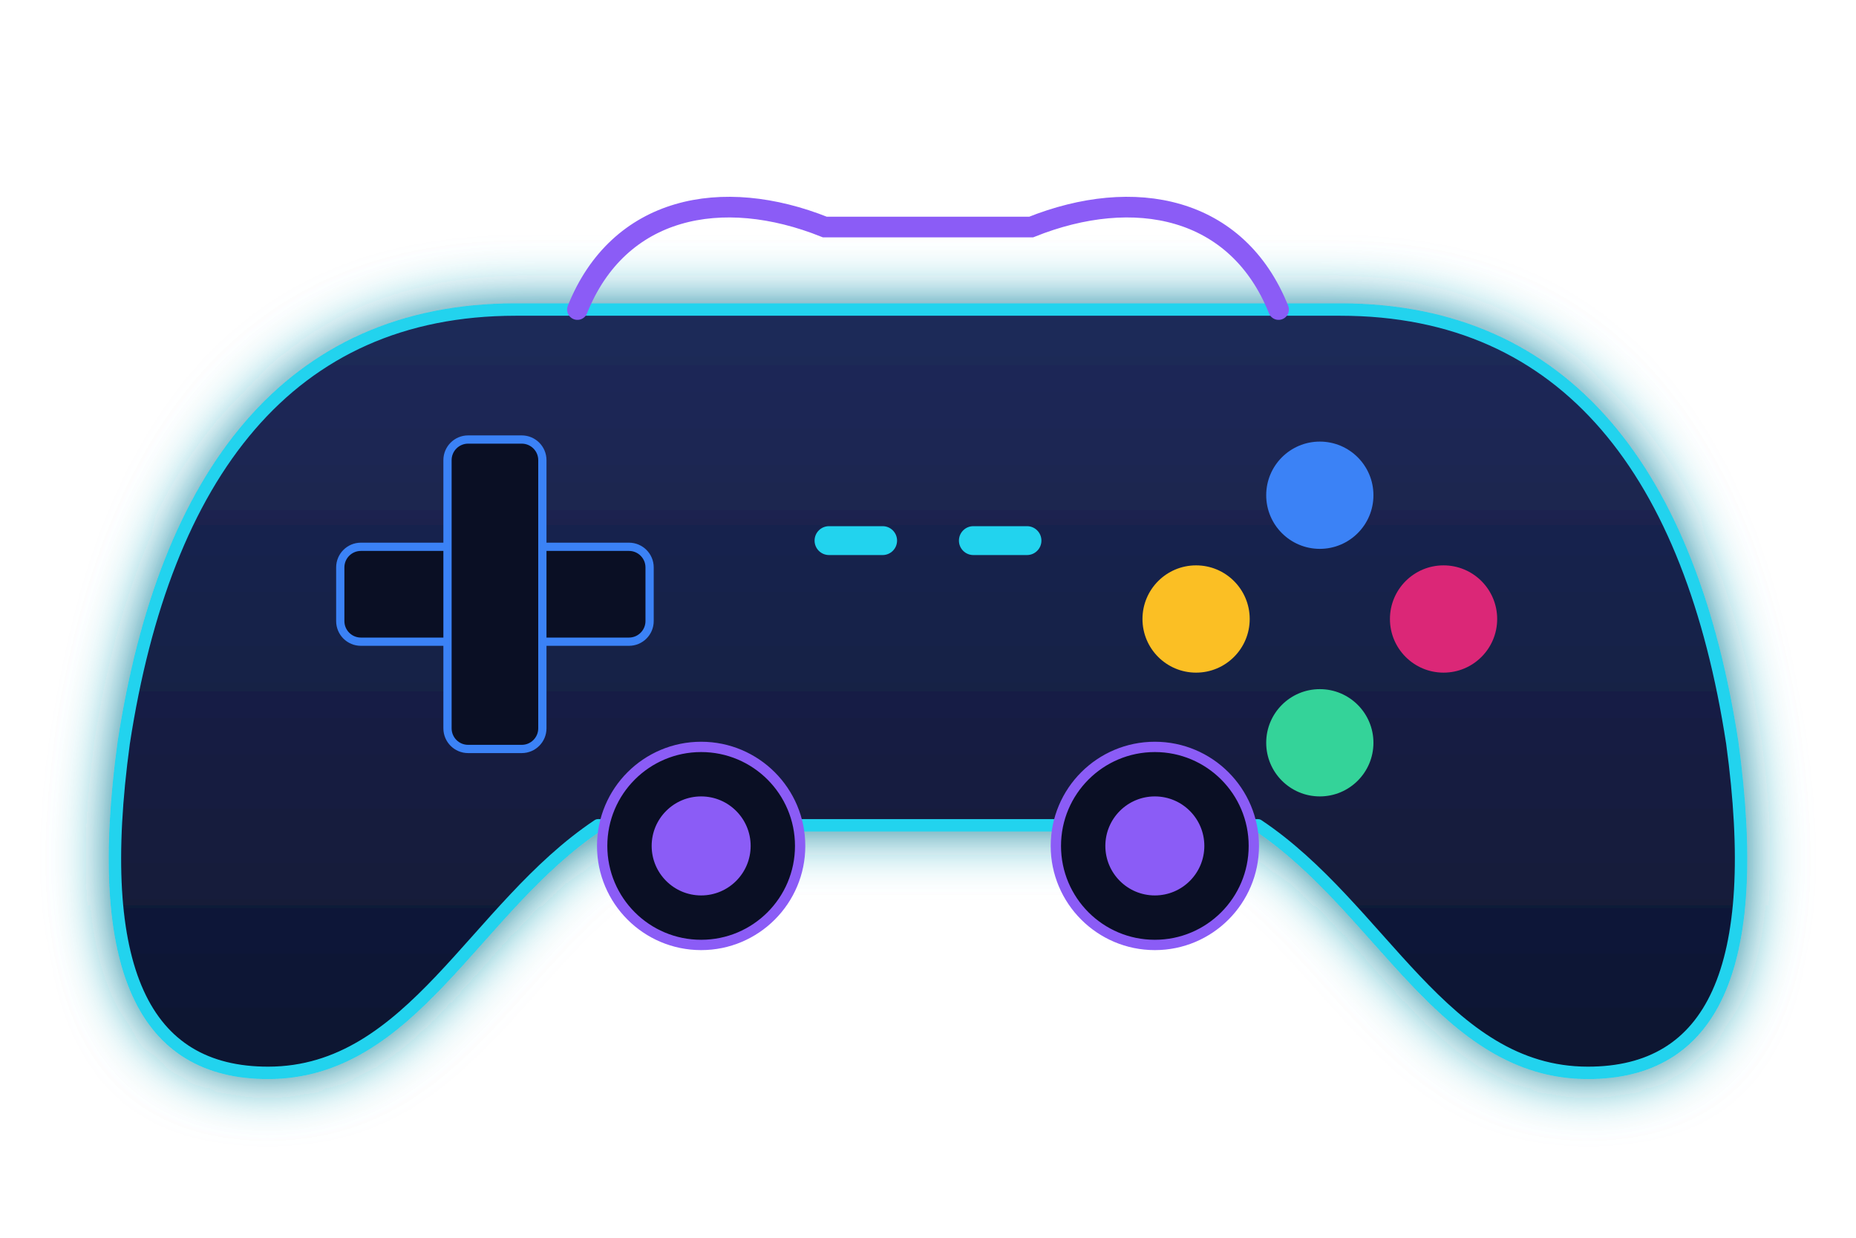









OmniDB
COLLEGE PROJECT
A Unified Cross-Platform Video Game Database
Balamurugan RMM · Vaishnavperumal M
Department of Computer Science and Design
Rajalakshmi Engineering College, Chennai, Tamil Nadu
Project Guide: Dr. P. Revathy
Notes:
Welcome everyone. Our project is OmniDB, a unified cross-platform video game database. The idea is simple: game information is spread across many stores and platforms, and OmniDB brings it into one place. Introduce yourselves (Balamurugan RMM and Vaishnavperumal M), mention the Department of Computer Science and Design at Rajalakshmi Engineering College, and thank our project guide, Dr. P. Revathy.

Slide 2




What is OmniDB?
The problem
Game information is spread across many stores
OmniDB
The idea
Bring it together in one centralized database
The goal
Make discovery and organisation easier
Notes:
OmniDB is a centralized video game database. Today, if you want to know about a game, you may have to visit Steam, Epic, GOG, PlayStation, Xbox and Nintendo stores separately. The diagram shows our idea: many platforms and storefronts feeding into one place. The goal is to make discovering and organising games easier.

Slide 3




The Problem
01
02
03
04
05
Scattered across stores
Hard to find games across platforms
Confusing editions & releases
Duplicate or inconsistent records
No single place to organise
Result: players jump between stores to find, compare and keep track of games.
Notes:
These are the problems we want to solve. One: game information is scattered across storefronts. Two: finding a specific game across platforms can be inconvenient. Three: different editions and platform releases can be confusing. Four: duplicate or inconsistent records make comparison difficult. Five: users may need separate places to organise their gaming information. We are not claiming statistics here; this is the problem we identified.

Slide 4


Our Solution
BEFORE · Fragmented
AFTER · Unified with OmniDB
One unified game catalog
Centralized game catalog
Platform & edition comparison
Search & filtering
Duplicate identification
Standardized game information
Foundation for personal gaming tools
Notes:
Before OmniDB, information is fragmented: each platform is its own island. After OmniDB, everything lives in one unified catalog. OmniDB addresses the problems through a centralized catalog, search and filtering, standardized game information, platform and edition comparison, duplicate identification, and a foundation for future personal gaming tools. Be honest in the Q&A: some of these are goals of the design, and the next slide shows exactly what is built today versus planned.

Slide 5




Features
CURRENT FOUNDATION
FUTURE ENHANCEMENTS
Unified game catalog
Personal game library
Keep your own collection
Large collection of games in one place
Wishlist
Save games you want
Frontend interface
Spending tracker
Built with Antigravity
Track what you spend on games
Price history
Search & filtering
See how prices change over time
To confirm: mark as current only if built
Cross-platform comparison
Compare editions across platforms
Notes:
This slide separates what exists from what is planned. On the left, in green, are the confirmed parts of our current website: a unified game catalog with a large collection of games, and a frontend built with Antigravity. The amber dashed card is search and filtering: before presenting, confirm with your own website whether it works, and either mark it current or remove it. On the right, in purple, are Future Enhancements: personal game library, wishlist, spending tracker, price history, and cross-platform comparison. These are proposals, not finished features.

Slide 6








Technology Stack
PLANNED TECHNOLOGY STACK
Frontend
Antigravity
Languages & libraries
CURRENT
TO CONFIRM FROM CODE
Application / API
REST API layer
Node.js
PLANNED
PROPOSED OPTION
Database
PostgreSQL
Canonical game IDs
PROPOSED OPTION
PROPOSED DESIGN
Data sources
Storefront / provider APIs
Validation rules
PLANNED
PLANNED
Only Antigravity is confirmed. Add exact languages and libraries after checking the project files.
Notes:
Be careful and honest on this slide. The only technology we confirm as already used is Antigravity, which we used to build the frontend. Before presenting, open your project files and add the exact languages, frameworks and libraries in the amber box. Everything else is the Planned Technology Stack: a REST API layer, a backend such as Node.js, a relational database such as PostgreSQL, and integration with storefront or data-provider sources. These are proposals that can change, not things already built.

Slide 7

System Architecture
User
Frontend Interface
Application / API Layer
Game Data & Database
Validation & Source Integration
Existing component
External storefronts & data providers (proposed)
Proposed component
No live storefront API integration is claimed. This is the intended design.
Notes:
This is the intended flow of the system. A user opens the frontend interface, which exists today. The frontend would talk to an application or API layer, which reads from a game data store and database. A validation and source-integration step would check data coming in from external storefronts and data providers. Green means it exists; purple dashed means proposed. We are not claiming that live API connections to any store are working today.

Slide 8
Data Model
PROPOSED DATA MODEL
Game
game_id (PK)
title
franchise
Edition
edition_id (PK)
game_id (FK)
edition_name
Platform
platform_id (PK)
name
1 : N
N : M
1 : N
Why separate them?
Store Offer
offer_id (PK)
edition_id (FK)
store_id (FK)
Store
store_id (PK)
name
Games stay unique, editions keep their differences, and offers hold store-specific details.
N : 1
Notes:
This is a proposed data model; we have not claimed it is implemented. A Game is the core title, for example one franchise entry. An Edition is a specific release of that game, such as a standard edition, deluxe edition or remaster. A Platform is where it runs, a Store is where it is sold, and a Store Offer ties one edition to one store. Separating these means we do not create duplicate game records for each edition or store, and we keep important differences between releases.

Slide 9

User Workflow
1
2
3
4
5
6
Open OmniDB
Browse or search
Filter games
Open game details
Compare platforms & editions
Organise games (if built)
Core journey
Planned / depends on features
Optional future actions
Save to wishlist
Record spending
Price-drop alerts
Notes:
This is a typical user journey. The user opens OmniDB, browses or searches the catalog, filters games, and opens a game to see details. Next they could compare platform or edition information, and use organisational features if they are implemented. The purple steps and the dashed boxes at the bottom, such as saving to a wishlist or recording spending, are future options, not features we currently claim.

Slide 10
Challenges & Solutions
CHALLENGE
APPROACH
Duplicate game titles
Canonical game IDs + duplicate-review workflow
1
Editions and remasters
Separate Game and Edition records
2
Inconsistent info across platforms
Validation rules + standard fields
3
Keeping information current
Source attribution + regular refresh
4
Expanding without breaking records
Validate before merging; keep IDs stable
5
Notes:
These are realistic challenges for any multi-platform game database. Duplicate titles are handled with canonical game IDs and a duplicate-review workflow. Editions and remasters are kept separate from the base game. Inconsistent information across platforms needs validation rules and standard fields. Keeping data current needs source attribution and regular refreshes. When the catalog grows, we validate new data before merging so existing records are not damaged. These are our planned approaches.

Slide 11

Future Roadmap
FUTURE GOALS · NOT YET IMPLEMENTED
PHASE 1
PHASE 2
PHASE 3
Foundation
Personal tools
Insights & reach
Backend & persistent database
Better catalog validation & duplicate detection
Personal game library
Wishlist management
Spending tracker
Price history & price alerts
Expanded platform coverage
Notes:
This roadmap shows where OmniDB could go next. Phase 1 builds the foundation: a backend with a persistent database, plus better validation and duplicate detection. Phase 2 adds personal tools: a personal game library, wishlist management and a spending tracker. Phase 3 adds price history and alerts and expands platform coverage. All of this is future work unless it is already built in your website.

Slide 12



Conclusion
One place to discover and organise games across ecosystems
Better visibility into platforms and editions
A foundation for comparison and personal gaming tools
Extensible: can grow without rebuilding the frontend from scratch
“One Game. Every Platform. One Database.”
Notes:
To summarise: OmniDB gives one place to discover and organise games across ecosystems, gives better visibility into platforms and editions, and is a foundation for comparison and personal gaming tools. It is extensible, so it can grow without rebuilding the existing frontend from scratch. Finish with the tagline: One Game. Every Platform. One Database.

Slide 13
Thank You
OmniDB
One Game. Every Platform. One Database.
QUESTIONS & DISCUSSION
Notes:
Thank the audience, the project guide Dr. P. Revathy, and the department. Invite questions. Likely questions: what is already built versus planned (answer using slides 5, 6 and 7), how duplicates will be handled (slides 8 and 10), and what comes next (slide 11).

